Slide 1
Analysis of long-term trends in precipitation and runoff. Case study Bistra hydrometrical station (Vişeu River).
Through nature Oaș meets Maramureș!
Horvath Cs. , Croitoru Adina
Funded by the EEA Grants – jointly financed by Iceland, Liechtenstein and Norway, Programme RO02 – Biodiversity and Ecosystem Services

Slide 2
Did stationarity die?
Over the last century, a global environmental change which seems is the result mainly to human activity, has become increasingly noticeable (IPCC 2014)
How did stationarity die?
If we accept Climate Change existence then …
WHY?
in order to understand the changing hydrological processes and select the most appropriate methods for hydraulic engineering design and water resources management in the future

Slide 3
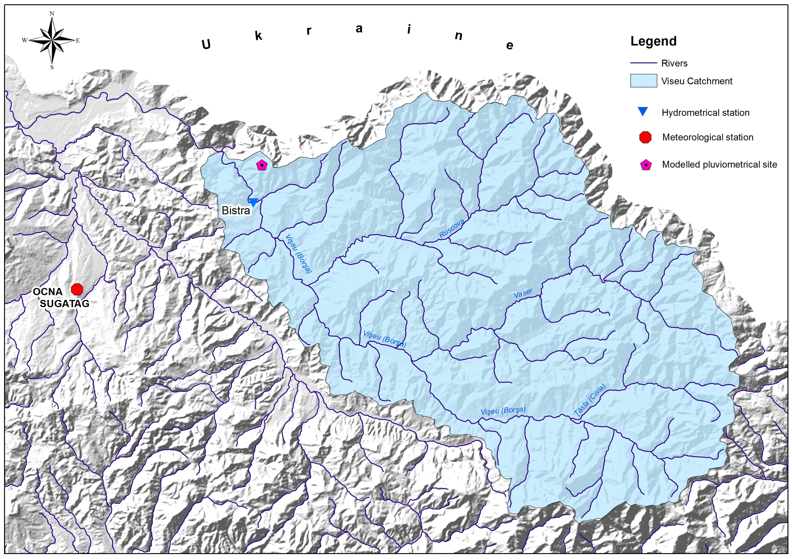
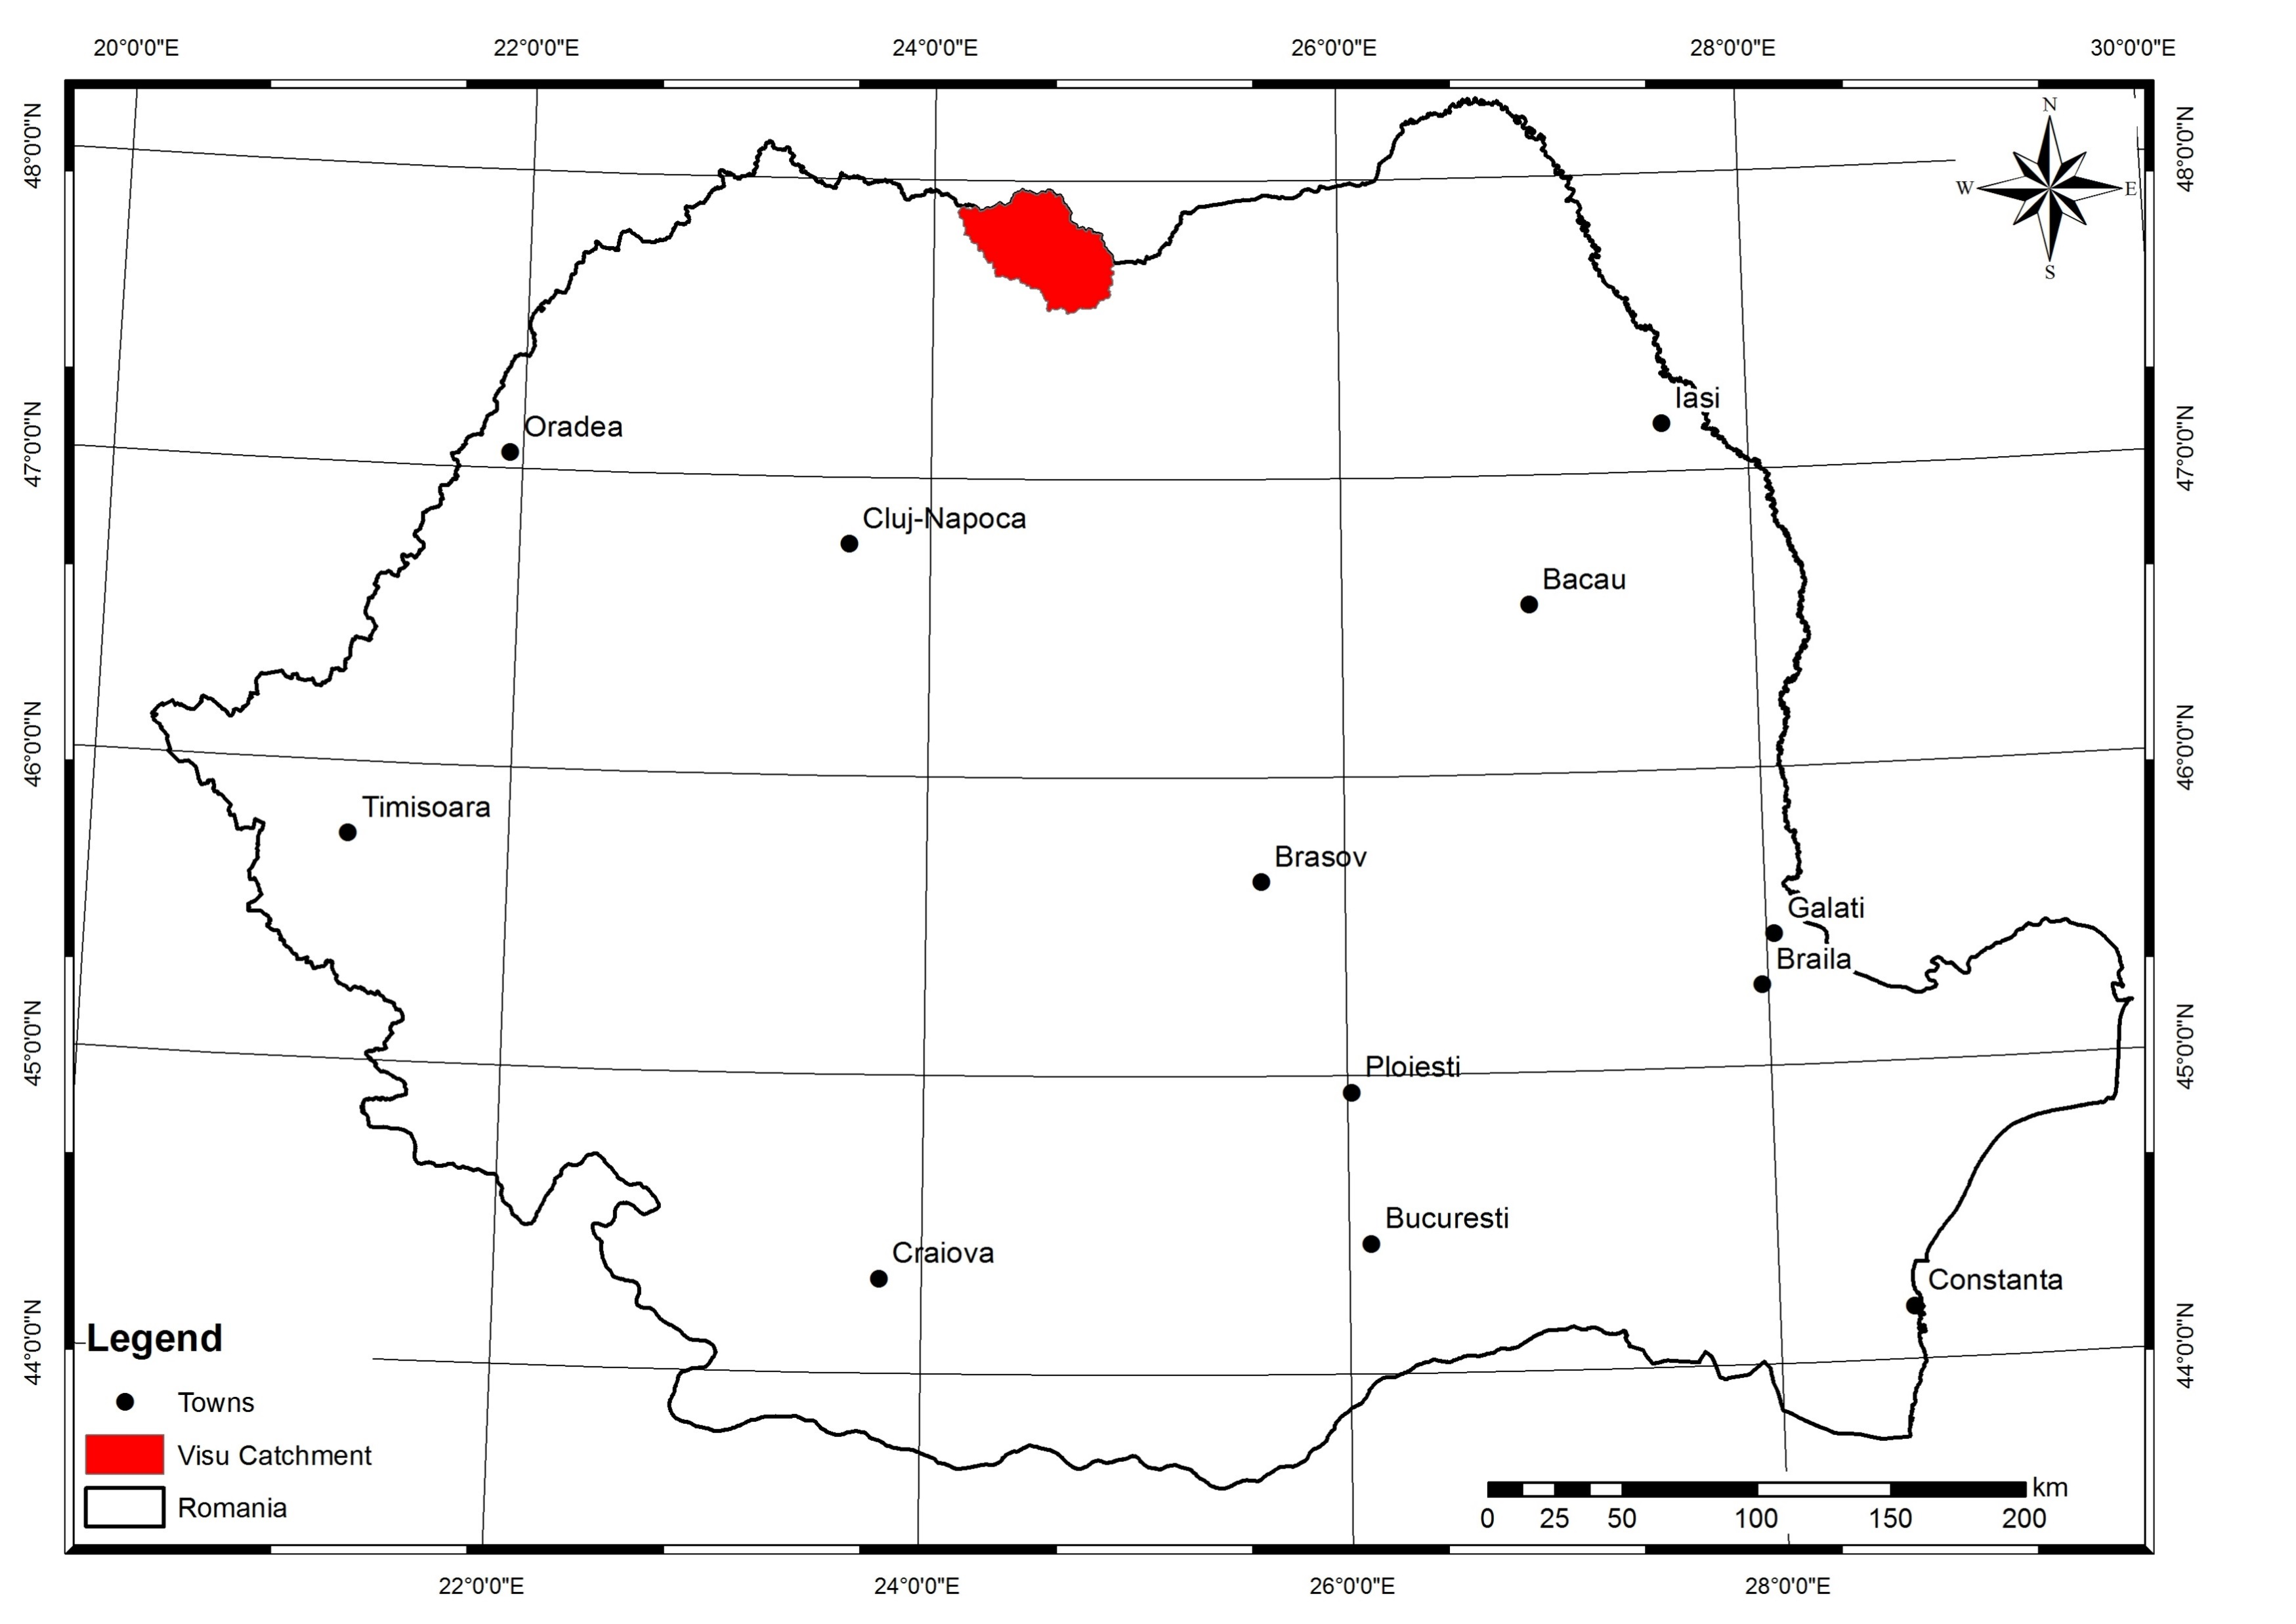
As the main tributary of the Tisa River from Romania’s Maramures Depression, the Viseu gathers its waters from a 1606 km2 watershed with an 80 km length from its confluence to its spring.
In significant part (over 60%) the watershed it is characterized by a mountainous relief, collecting the waters from the slopes of the Maramures and Rodnei Mountains with heights over 2300 meters.
The high mean altitude (997 m) and the Northern position give its runoff regime a moderately nival characteristic (Ujvari, 1972).

Slide 4
DATA
mean monthly discharge data, for the 1961-2008 period
(Global Runoff Data Centre) GRDC database.

Slide 5
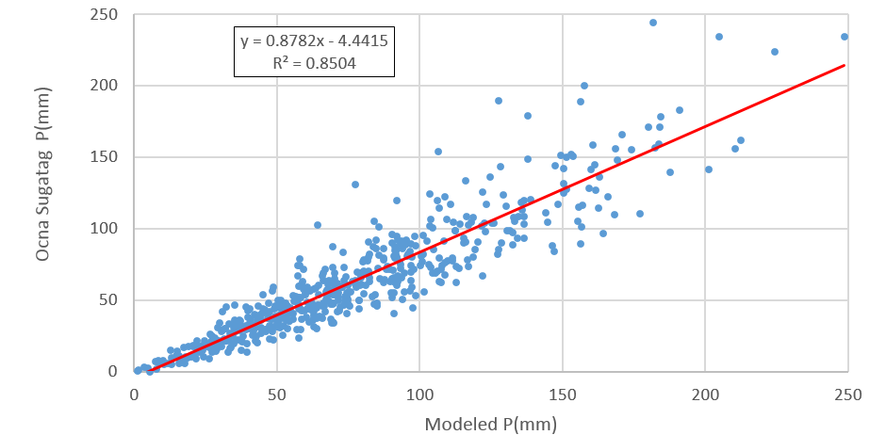
Correlation between the measured and modeled precipitation data (1961-2008)
CARPATCLIM Database © European Commission - JRC, 2013

Slide 6
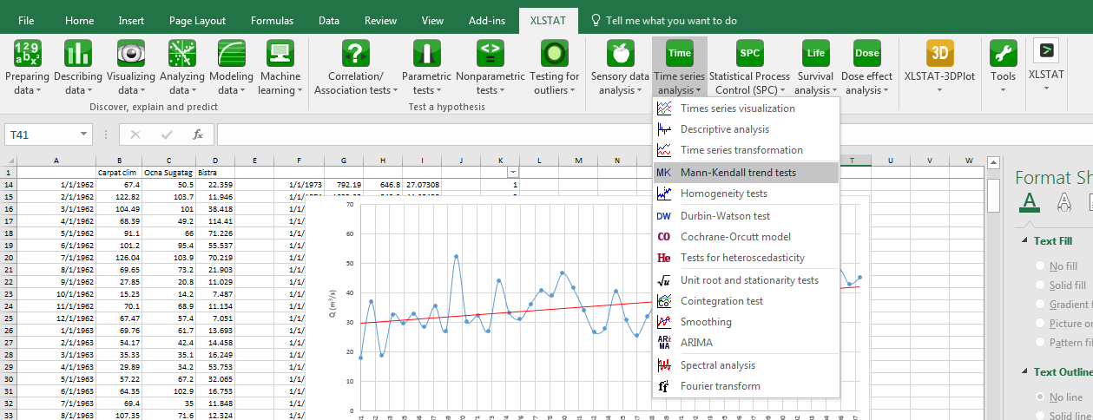
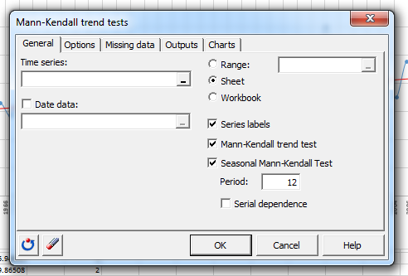
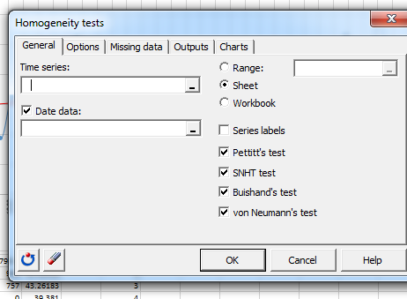
Methods
For the analysis we used the non-parametric Mann–Kendall's test and the linear regression test to detect trends in annual, seasonal, and monthly data
and also Homogeneity tests to detect break points
XLSTAT software a Microsoft Excel add-on

Slide 7
Results
the precipitation shows no trend in the monthly data (using measured and modeled values) using Mann–Kendall's test (monthly, seasonal, Max, Min) only if we analyzed the summed yearly data in which case we identified a positive trend
Mann-Kendall trend test / Two-tailed test (Series1):
Kendall's tau | 0.039
S | 44.000
Var(S) | 12658.667
p-value (Two-tailed) | 0.702
alpha | 0.05
An approximation has been used to compute the p-value.
Test interpretation:
H0: There is no trend in the series
Ha: There is a trend in the series
As the computed p-value is greater than the significance level alpha=0,05, one cannot reject the null hypothesis H0.
The risk to reject the null hypothesis H0 while it is true is 70,23%.
Winter
Mann-Kendall trend test / Two-tailed test (Series1):
Kendall's tau | 0.217
S | 245.000
Var(S) | 7583.594
p-value (Two-tailed) | 0.005
alpha | 0.05
An approximation has been used to compute the p-value.
Test interpretation:
H0: There is no trend in the series
Ha: There is a trend in the series
As the computed p-value is lower than the significance level alpha=0,05, one should reject the null hypothesis H0, and accept the alternative hypothesis Ha.
The risk to reject the null hypothesis H0 while it is true is lower than 0,51%.
Year

Slide 8
Results
In case of the classic linear regression test al trends are positive, in case of both data
Precipitations
(mm)
Discharge
m³/s

Slide 9
in case of the runoff the Mann–Kendall's test identified generally positive trends
Results
 | Winter | Spring | Summer | Autumn | Max | Min | Year
Kendall's tau | 0.268 | 0.259 | -0.018 | 0.282 | 0.154 | 0.402 | 0.300
p-value (Two-tailed) | 0.007 | 0.009 | 0.867 | 0.004 | 0.125 | < 0,0001 | 0.002
alpha | 0.05 | 0.05 | 0.05 | 0.05 | 0.05 | 0.05 | 0.05
Sen's slope: | 0.216 | 0.57 | -0.022 | 0.333 | 0.438 | 0.162 | 0.283
 | Jan | Feb | Mar | Apr | May | Jun | Jul | Aug | Sep | Oct | Nov | Dec
Kendall's tau | 0.246 | 0.175 | 0.239 | 0.122 | 0.230 | -0.016 | -0.025 | 0.128 | 0.289 | 0.287 | 0.170 | 0.158
p-value (Two-tailed) | 0.013 | 0.081 | 0.016 | 0.225 | 0.021 | 0.881 | 0.811 | 0.205 | 0.004 | 0.004 | 0.090 | 0.116
alpha | 0.05 | 0.05 | 0.05 | 0.05 | 0.05 | 0.05 | 0.05 | 0.05 | 0.05 | 0.05 | 0.05 | 0.05
Sen's slope: | 0.218 | 0.134 | 0.597 | 0.421 | 0.506 | -0.043 | -0.042 | 0.091 | 0.325 | 0.3 | 0.254 | 0.193

Slide 10
Results
In case of precipitations the homogeneity tests present a change in the series linked to 1989 in the autumn and 1997 for the yearly values
Pettitt's test: | Winter | Spring | Summer | Autumn | Max | Min | Year
K | 161.000 | 182.000 | 153.000 | 257.000 | 200.000 | 205.000 | 226.000
t | 1993 | 1976 | 2003 | 1989 | 2000 | 1997 | 1992
p-value (Two-tailed) | 0.383 | 0.250 | 0.448 | 0.032 | 0.175 | 0.152 | 0.085
alpha | 0.05 | 0.05 | 0.05 | 0.05 | 0.05 | 0.05 | 0.05
Standard normal homogeneity test (SNHT):
T0 | 4.788 | 10.947 | 6.692 | 8.444 | 11.365 | 4.408 | 9.340
t | 1961 | 2005 | 2003 | 1989 | 2002 | 1997 | 1997
p-value (Two-tailed) | 0.309 | 0.019 | 0.103 | 0.041 | 0.007 | 0.371 | 0.023
alpha | 0.05 | 0.05 | 0.05 | 0.05 | 0.05 | 0.05 | 0.05
Buishand's test:
Q | 5.568 | 6.580 | 5.533 | 9.950 | 7.806 | 6.178 | 8.993
t | 1993 | 1993 | 2003 | 1989 | 2002 | 1997 | 1997
p-value (Two-tailed) | 0.431 | 0.241 | 0.448 | 0.017 | 0.110 | 0.310 | 0.040
alpha | 0.05 | 0.05 | 0.05 | 0.05 | 0.05 | 0.05 | 0.05

Slide 11
Results
In case of the discharge data the homogeneity tests present a change linked to the end of the XX century, mainly the 1993 year
Pettitt's test: | Winter | Spring | Summer | Autumn | Max | Min | Year
K | 277.000 | 293.000 | 155.000 | 282.000 | 207.000 | 384.000 | 299.000
t | 1993 | 1993 | 1985 | 1988 | 1993 | 1992 | 1993
p-value (Two-tailed) | 0.018 | 0.011 | 0.422 | 0.015 | 0.142 | 0.000 | 0.007
alpha | 0.05 | 0.05 | 0.05 | 0.05 | 0.05 | 0.05 | 0.05
Standard normal homogeneity test (SNHT): | Winter | Spring | Summer | Autumn | Max | Min | Year
T0 | 9.000 | 10.339 | 2.021 | 8.529 | 4.939 | 21.517 | 11.322
t | 1993 | 1993 | 1961 | 1989 | 1997 | 1994 | 1993
p-value (Two-tailed) | 0.034 | 0.014 | 0.851 | 0.083 | 0.286 | < 0,0001 | 0.011
alpha | 0.05 | 0.05 | 0.05 | 0.05 | 0.05 | 0.05 | 0.05
Buishand's test: | Winter | Spring | Summer | Autumn | Max | Min | Year
Q | 9.736 | 10.435 | 4.282 | 10.000 | 7.119 | 14.762 | 10.920
t | 1993 | 1993 | 1985 | 1989 | 1993 | 1994 | 1993
p-value (Two-tailed) | 0.021 | 0.012 | 0.735 | 0.014 | 0.174 | < 0,0001 | 0.006
alpha | 0.05 | 0.05 | 0.05 | 0.05 | 0.05 | 0.05 | 0.05

Slide 12
Discussions
By analyzing the runoff and the precipitations one can describe and understand the water resources of an area
Even if the period is short to have conclusions regarding the climatic change in the area we must highlight the changes which occurred
It is interesting to observe that the change in the precipitation series can’t be seen in the runoff, as it should be

Slide 13
Thank you for your patience!
Through nature Oaș meets Maramureș!
Funded by the EEA Grants – jointly financed by Iceland, Liechtenstein and Norway, Programme RO02 – Biodiversity and Ecosystem Services

